Slide 1
Immigrant Segmentation for Appropriate Accommodation using EDA and Clustering Analysis
A Presentation on:
Presented By: Group 4
Name of group members:
Devika Dhumal
Sunny Khade
Sanskriti Patole
Omkar Takale
Guided By: Prof. P. P. Dandavate

Slide 2

AGENDA
Introduction
Overview
Motivation
Objective
Literature Survey
Problem Statement
Requirement and Feasibility
Future Scope
Approach
UML
Current Progress
References
Conclusion

Slide 3

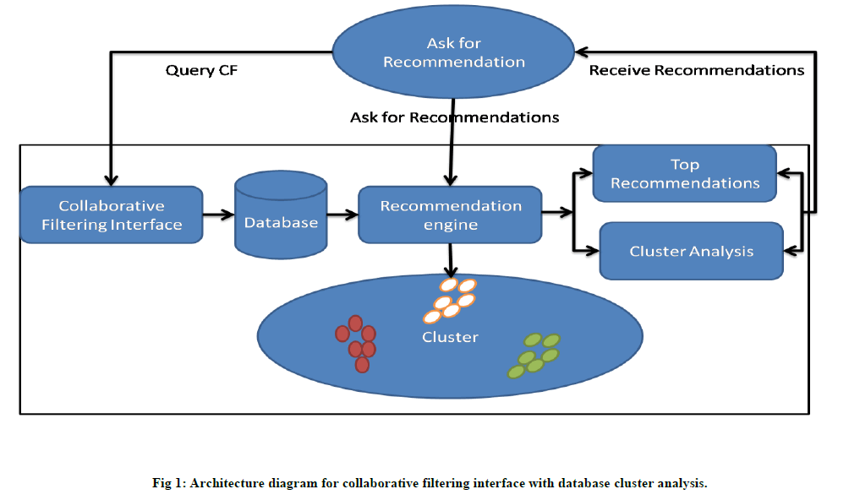
INTRODUCTION
Imagine a scenario where a person has newly moved into a new location. They already have certain preferences, certain tastes. It would save both the student and the food providers a lot of hassle if the student lived close to their preferred outlets. Convenience
means better sales, and saved time for the customer.
We will be performing Exploratory Data analysis on Geolocational Data. Further we shall use Clustering Analysis (eg. K-Means Clustering etc) for immigrant segmentation, i.e., dividing the immigrants into groups according to their individual Point-of-Interests (POI).
We are using the most optimized clustering algorithm for segmenting the areas (in the city we have chosen for analysis) according to features like restaurants and other amenities in proximity to the desired location.

Slide 4
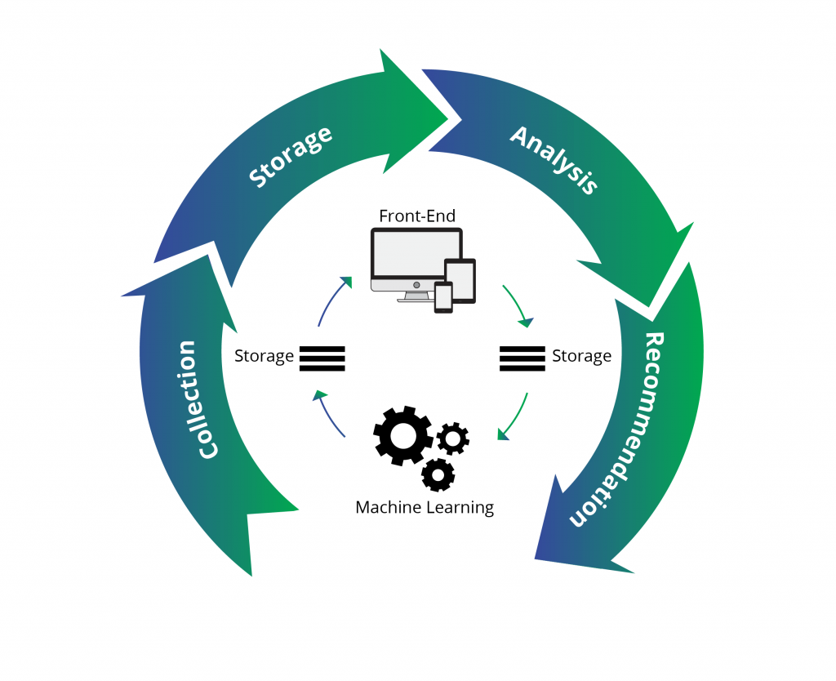
OVERVIEW
➔ Every human is different and has his own preferences and likings,
based on which they take their daily life decisions which might
include what food to eat, what place to visit, what clothes to wear,
etc.
➔ Our project mainly focuses on Immigrants (e.g., students who
are new to the city, the people who have moved to a different city or
country) have certain choices in terms of the amenities they want,
their food choices, their budget and so on.
➔ To help immigrants we present them a personalized system.
And to build such a system we are performing Exploratory Data
Analysis and Cluster Analysis on ‘geo-locational’ and ‘Immigrant
Preference’ datasets to help them find their suitable
accommodation.
➔ This project will help immigrants choose an area which will be
most convenient for them based on their personal opinions and
choices.

Slide 5
Motivation
MOTIVATION
Helping immigrants find the most convenient and suitable place to live.
Segmenting the city/region of choice according to the amenities, cost of living and other factors.
Beneficial not only for the immigrants but also for the food providers and other service providers in the area.

Slide 6

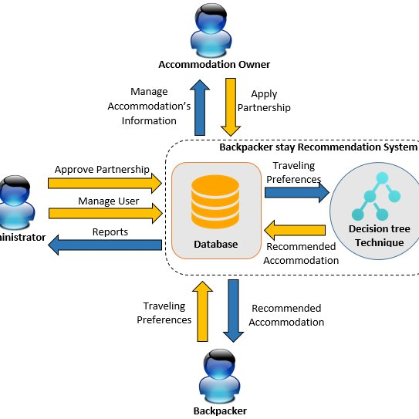
Objective
Why Accommodation Recommendation systems?
– There has been a rapid growth of immigrants all over the country.
To find a convenient place to live is the first step and the most crucial step for any person new to a city.
– Providing a hassle free method to find such a place is the objective of this project.
– Various factors (immigrant preferences) can be taken into consideration to figure out the suitable location – To identify the most relevant Interests for each user – Showcase personalized content to each user – Suggest top offers and discounts to the right user – It increases relevance for search through increased consumption
Clustering technique

Slide 7
1.Literature Survey
Paper | Author | Methodology | Drawback | Overcome
Improving Accuracy of Recommen der System by Item Clustering. | KhanhQuan Truong,Fuyuki Ishikawa, Shinichi Honiden | In this paper, Recommender System (RS) predicts user's preference , and then recommends highly-predicted items to user. | The number of attributes is often very large and so is the diversity amongst them, users who have similar preference in one category may have totally different judgement on attributes of another kind. | We propose a method to cluster attributes, so that inside a cluster, similarity between users does not change significantly from one attribute to another .

Slide 8
2.Literature Survey
Paper | Author | Methodology | Drawback | Overcome
Recommend er Systems: Algorithms, Evaluation and Limitations. | Mubaraka Sani Ibrahim and Charles Isah Saidu | This paper also discusses the state of art machine learning based recommendatio n models including Clustering models and Bayesian Classi fiers. Further, we discuss the widespread ap plication of recommender systems. | It may provide inaccurate results if data entered incorrectly. Since the feature representatio n of the attributess are handengineered to some extent, many technique requires a lot of domain knowledge. | Good Knowledge of model can capture the specific interests, and can recommend niche items that very few other users are interested in.

Slide 9
3.Literature Survey
Paper | Author | Methodology | Drawback | Overcome
Point-of-interest lists and their potential in Recommendati-on systems | Stamatelato s,G., Drosatos,G., Gyftopoulo s, S. et al. | This paper proposes a new idea on personalized interest based recommender system which is based on lists of end user point of interests. | The model can only make recommendat ions based on existing interests of the user. In other words, the model has limited ability to expand on the users' existing interests. | Recommend new experiences and attributes to attracts the end users interest .

Slide 10
Problem Statement
“Targeting Individual Point-Of-Interests (POI) to recommend appropriate accommodations with the help of exploratory data analytics using clustering algorithm”
Goals and strategy
Modeling and Insight gathering
Data Collection and Attribute Classification
Exploratory Data Analytics
Feature Extraction and Engineering
Analysis and Requirement Verification
Data Preparation and processing

Slide 11
Requirements and Feasibility
1. Hardware Interfaces
Graphic Card
512 SSD
8 GB RAM
2. System Specifications
Language: Python3
IDE: Jupyter Notebook
Dataset: Kaggle website
Libraries used:
Data Fetch: Pandas
Data processing: Numpy
Visulatization: Matplotlib/ Tabluae Desktop s/w
Clustering Analysis: ScikitLearn
Map Display: Folium

Slide 12
Future Scope
Clustering Analysis: Market Research, Pattern Recognition, Image Processing.
Exploratory Data Analysis: is used to perform initial investigation on data to derive predictions and information.
In General: Governments can use the same data work flow to predict appropriate accommodations for mass refugees in their countries.
Analytics will play an important role in data security. Analytics are already transforming differential privacy, intrusion detection, digital watermarking and malware countermeasures.

Slide 13
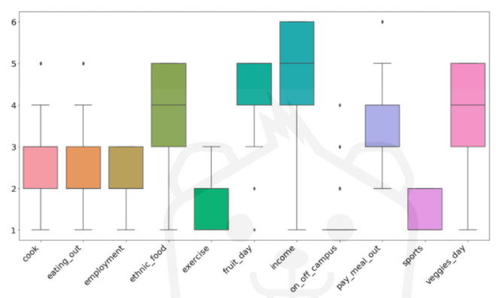
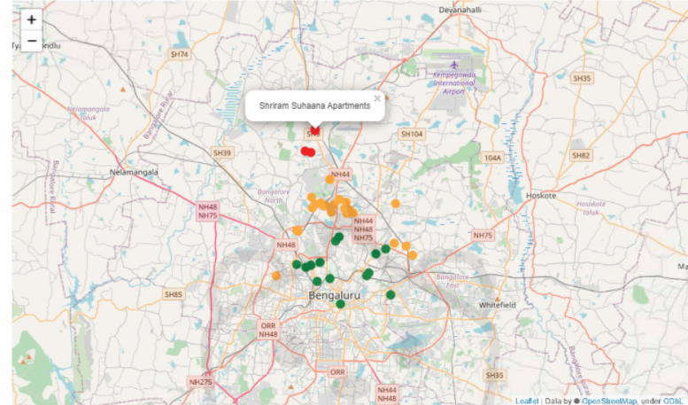


APPROACH
HIGH LEVEL APPROACH
Data Collection
(Data Cleaning via Pandas)
(Using Matplotlib /Seaborn /Pandas)
(REST APIs)
(Using ScikitLearn)
(Using Folium/Seaborn)
Fetch Datasets from the relevant locations
Clean the Datasets to prepare them for analysis.
Visualize the data using boxplots.
Fetch Geolocational Data from the Foursquare API.
Use K-Means Clustering to cluster the locations
Present findings on a map.
EXPECTED VISUALIZATION/OUTCOME
BOXPLOT for Visualization
Cluster Representation on Locational outcome

Slide 14
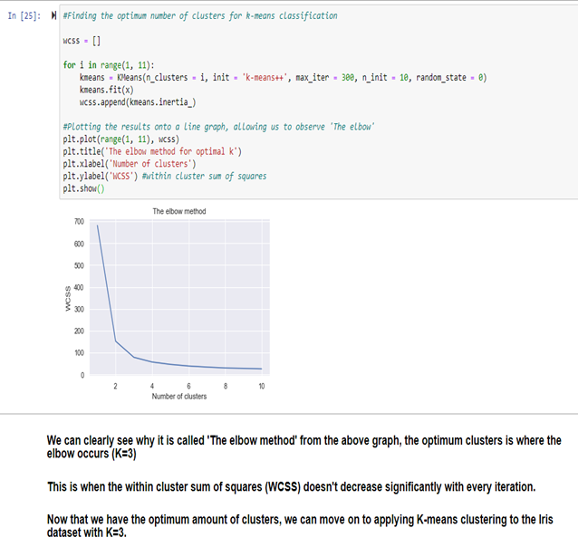
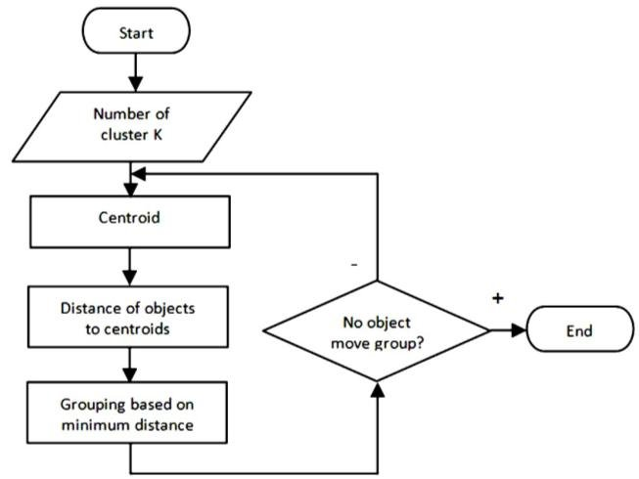
APPROACH (ALGORITHM)

Slide 15

UML- Use Case Diagram
Actor: USER
Distance: from desired location
Food: In Budget with the right preference
Budget: Total Capital allocated
Recommendation: Accordingly
Actor: ADMIN
Gathering: Collecting and processing relevant data.
Analysis and cluster: analyze and run algorithms.
Outcome: Show Results
Food
Include
Budget
Preferences
Distance
Extend
Collecting Data
Include
Approach
USER
Process n visualize
ADMIN
Clustering
API requests
Plot map

Slide 16
UML – Activity Diagram
ADMIN
SYSTEM
Problem Statement
Rediscuss
Approved
Start Collecting relevant data
Cleaning and Processing Data
Visualize
Start running Clustering Algorithms
Make interpretations
Get Optimum value for K using algo
Plot using API request to get locations and value for k
Generate Predictions
Check Accuracy
Display Expected Outcome
Show predictions on map

Slide 17
UML – SEQUENCE Diagram
USER
ADMIN
SYSTEM
Preferences
Collecting Data
Cleaning and Processing Data
Visualization and making interpretations
Running clustering algorithms
get optimum value for k from the algorithm
use REST API to request locations
Check Accuracy
Generate Predictions
Get appropriate accommodation suggestions
Plot and Display expected Outcome

Slide 18
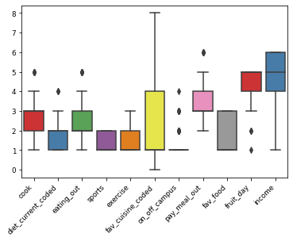
Current Progress
Box plot showing the spread
of data in the food preferences
dataset used in our algorithm.

Slide 19
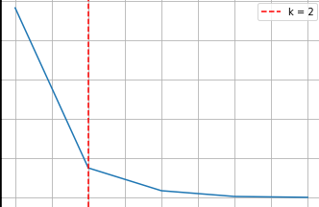
Current Progress
Graph of the elbow method that is used to
determine the ideal number of clusters for
clustering (on the food preferences dataset
used in our algorithm).
The Clustering algorithm used is the
K-Means Clustering Algorithm.

Slide 20
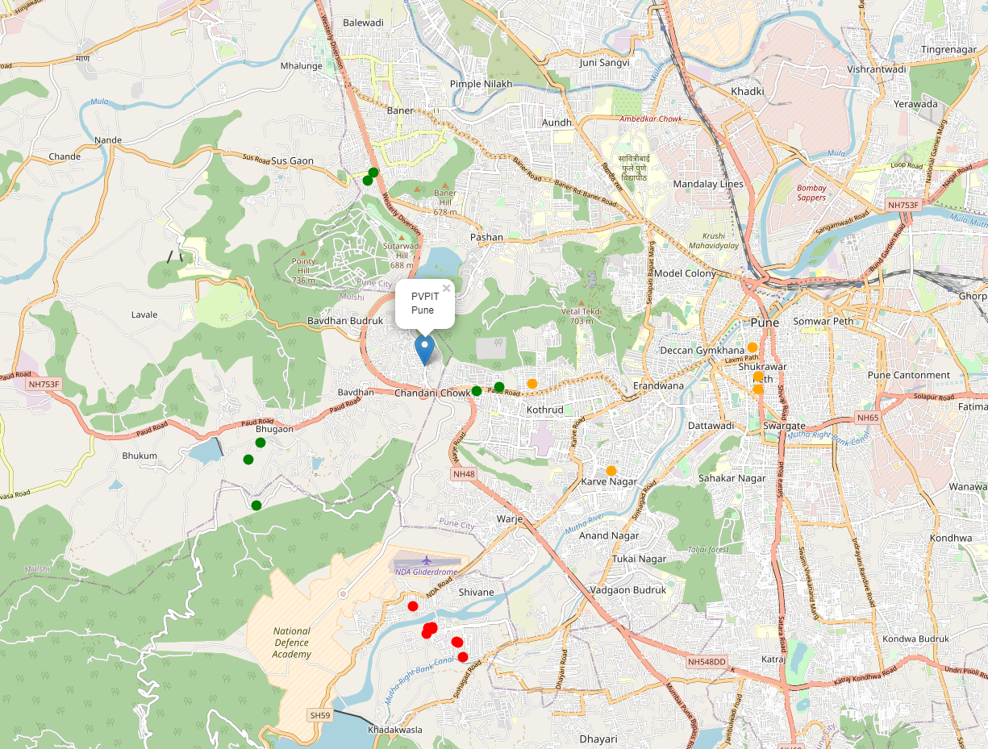
Current Progress
Ideal locations for immigrants plotted
on the map. The immigrants were
divided into three groups/clusters
during cluster analysis and each colour
represents a cluster. The location for
analysis is PVPIT Bavdhan, Pune and
we obtained the geolocational data
for the above mentioned location
with the help of APIs.

Slide 21
References
K. Gao et al., "Exploiting Location-Based Context for POI Recommendation When Traveling to a New Region, " in IEEE Access, vol. 8, pp. 52404-52412, 2020, doi: 10.1109/ACCESS.2020.2980982.
Stamatelatos, G., Drosatos, G., Gyftopoulos, S. et al. Point-of-interest lists and their potential in recommendation systems. Inf Technol Tourism 23, 209–239 (2021). https://doi.org/10.1007/ s40558-021-00195-5
Dietz, L.W., Sen, A., Roy, R. et al. Mining trips from location-based social networks for clustering travelers and destinations. Inf Technol Tourism 22, 131–166 (2020).
K. Gao et al., "Exploiting Location-Based Context for POI Recommendation When Traveling to a New Region, " in IEEE Access, vol. 8, pp. 52404-52412, 2020, doi: 10.1109/ACCESS.2020.2980982.
Singh, Ashwani & Soundarabai, Paulsingh. (2017). Collaborative filtering in movie Recommendation System based on Rating and Genre. IJARCCE. 6. 465-467. 10.17148/IJARCCE.2017.63107.
Xu, Chonghuan & Ju, Chunhua & Qiang, Xiaodan. (2015). Efficient Collaborative Filtering Using Particle Swarm Optimization and K-Harmonic Means Algorithm. Journal of Computational and Theoretical Nanoscience. 12. 6334-6342. 10.1166/jctn.2015.4675.
Qing Li and Byeong Man Kim, "Clustering approach for hybrid recommender system," Proceedings IEEE/WIC International Conference on Web Intelligence (WI 2003), 2003, pp. 33-38, doi: 10.1109/WI.2003.1241167.
Sahu, Satya & Nautiyal, Anand & Prasad, Mahendra. (2017). Machine Learning Algorithms for Recommender System - a comparative analysis. International Journal of Computer Applications Technology and Research. 6. 97-100. 10.7753/IJCATR0602.1005.
Basu, C., Hirsh, H., and Cohen, W. (1998). Recommendation as Classification: Using Social and Content-based Information in Recommendation. In Recommender System Workshop '98. pp. 11-15.
Jie Lu, Dianshuang Wu, Mingsong Mao, Wei Wang, Guangquan Zhang,Recommender system application developments: A survey,Decision Support Systems,Volume 74,2015,Pages 12-32, ISSN 0167-9236

Slide 22
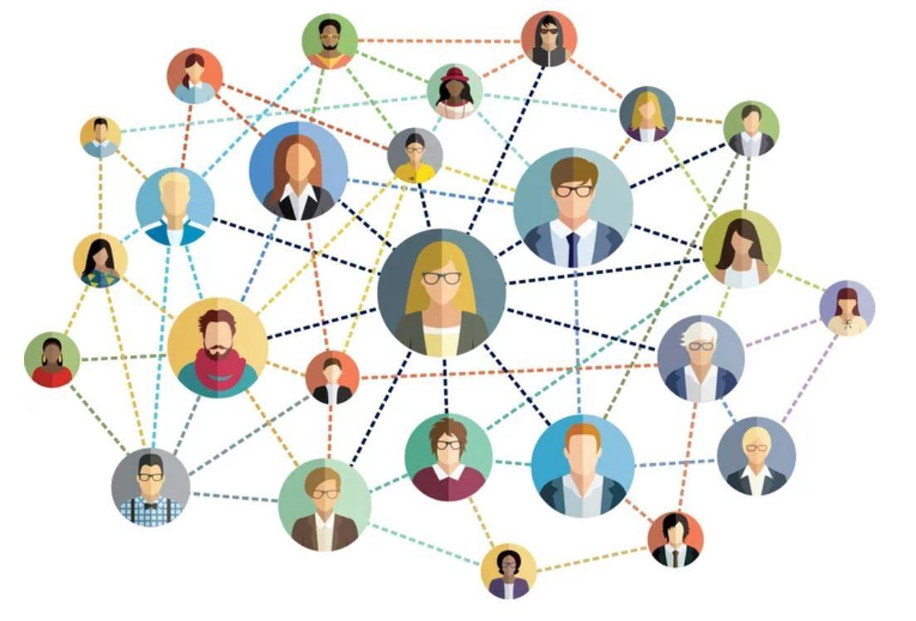
Conclusion
Recommender structures are proving to be a useful device for addressing a part of the records overload phenomenon from the internet. Its evolution has followed the evolution of the internet.
Latest research shows the use of Clustering Analysis in developing of more accurate recommender system. These types of methods are commonly used in e-commerce business.

Slide 23
Thank You

